Slide 1
Data Processing System
9/18/20 Update

Slide 2
Overview
DPS Client
Protobuf Protocol
DPS Batch Processor
Code Base Overview

Slide 3
DPS Client – Protobuf Protocol
DPS Client sent only in JSON format
Takes unnecessary space
Increases processing time by converting strings to numbers
Added the Protobuf protocol
Consumes less space (uses binary format)
Faster processing (no conversion from string to binary)
Both JSON and Protobuf are supported
JSON for debugging (easier to read and edit by hand)
Protobuf for production systems (hard to debug, but performant)

Slide 4
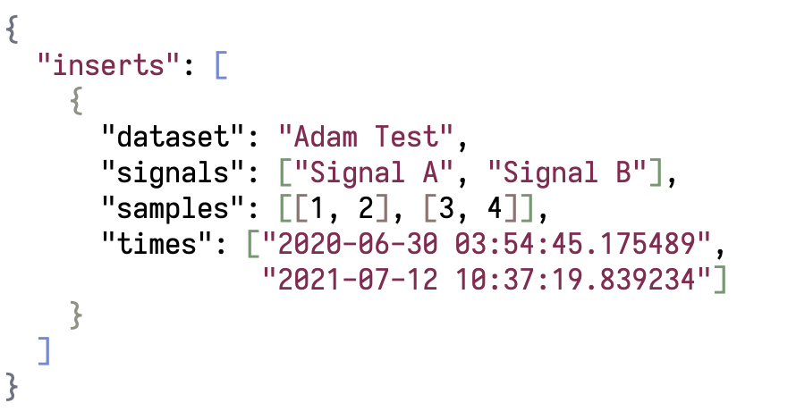
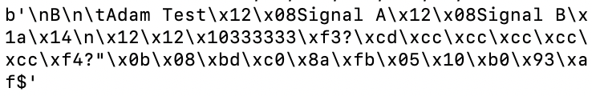
DPS Client – Protocol Differences
JSON API Request
221 bytes
Protobuf API Request
68 bytes

Slide 5
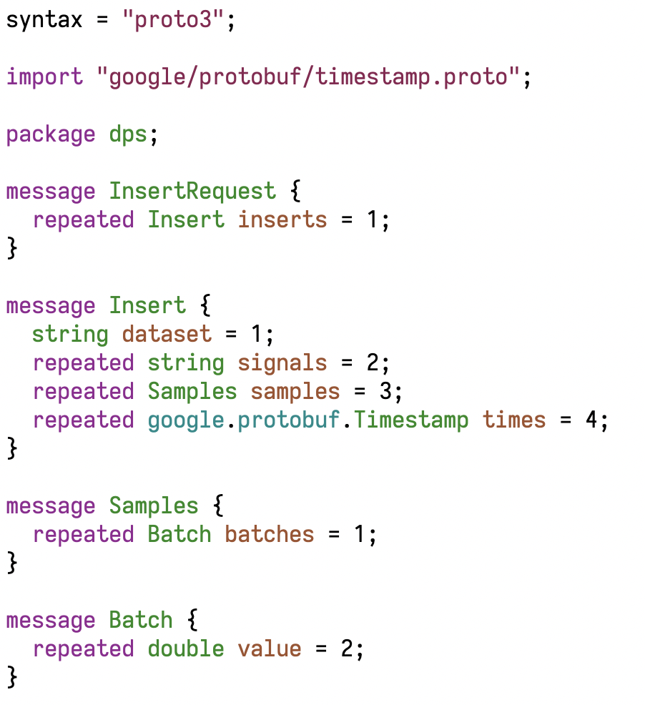
DPS Client – Protobuf Schema
Strings are still used, sparingly.
Protobuf has a timestamp type that can be expressed in binary (saves over 20 bytes per sample).
Numbers are represented in binary.

Slide 6
DPS Client – Protobuf Summary
Connect more devices to the system
Lower the latency of data collection
Greater system throughput (high frequency collection)
Example: Sending 1000 samples of 3 signals takes…
176,927 bytes using JSON
41,757 bytes using Protobuf

Slide 7
DPS Batch Processor
Micro-service for computing KPIs in batches.
Backend interface for Mike’s original mock-up.
Uses our existing KPI code.
Allows for clustering multiple batch processes.
The algorithm is outlined in the following slides.

Slide 8
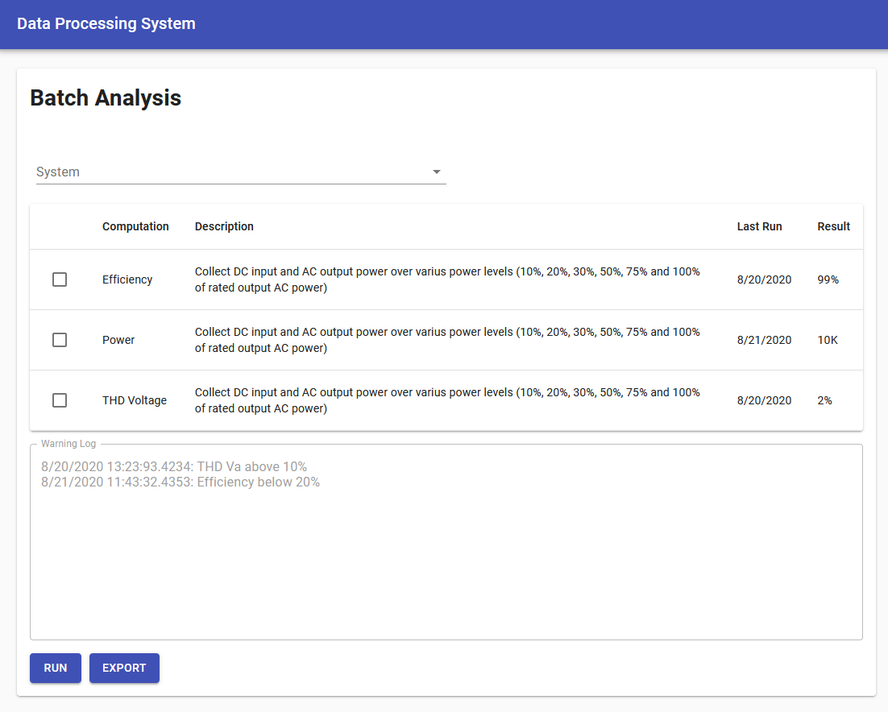
DPS Batch Processor – Algorithm
Step 1: Acquire Batch Process from User Interface.
A ”Batch Process” is the computer’s representation of Mike’s original mock-up.

Slide 9
DPS Batch Processor – Algorithm
Step 2: Fetch signals from Database Manager and store in memory.
For a small window of data (such as 1 second).
Window must be at least the size of the largest windowed KPI.

Slide 10
DPS Batch Processor – Algorithm
Step 3: With the signals from last step, compute the KPIs for the data.
Calls our existing KPI code.

Slide 11
DPS Batch Processor – Algorithm
Step 4: Send the KPIs back to the Database Manager with a special signal name (in a different dataset).
This will store the KPIs in TimescaleDB.
These KPIs are essentially streaming values. They have not yet been aggregated (e.g. average, min, max).

Slide 12
DPS Batch Processor – Algorithm
Step 5: Repeat Steps 2, 3, and 4 until the entire batch has been processed.

Slide 13



DPS Batch Processor – Algorithm
Step 6: Using the Database Manager, perform an aggregation (e.g. average, max, min) on the newly inserted KPIs to provide a final KPI value for the batch process.

Slide 14
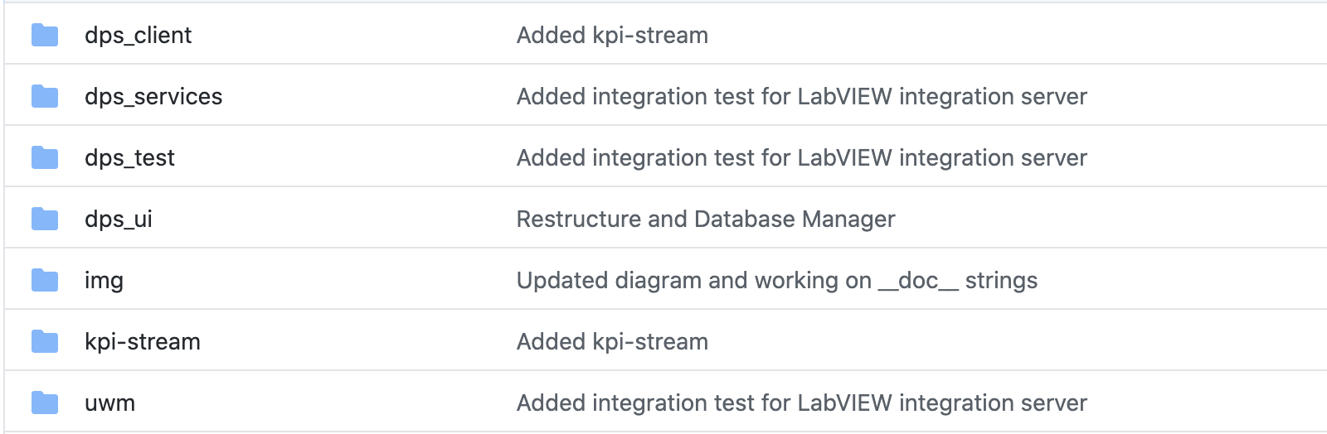
Code Base Overview
GitHub repository: https://github.com/bergerab/dps
Includes Python packages (dps_client, dps_services, dps_test), the React UI (dps_ui), UWM specific integrations (uwm), and our existing KPI code (kpi-stream).

Slide 15
Code Base Overview – dps_services
Contains implementation of the micro-services:
DPS Manager
DPS Batch Processor
And a library for implementing:
DPS Database Manager
Installation and usage of dps_services is only necessary when implementing a Database Manager.
A working Database Manager can be found at:
https://github.com/bergerab/dps/tree/master/uwm/database_manager
Install with “python3 setup.py install” or “pip3 install .”

Slide 16
Code Base Overview – dps_services
Includes automated (unit) tests
Run unit tests with “python3 setup.py test”
Validates KPI computations produce accurate values, and the API is functional.

Slide 17
Code Base Overview – dps_client
Implementation for sending signal samples to a Database Manager.
Install with “python3 setup.py install” or “pip3 install .”
Example usage on next slide.

Slide 18
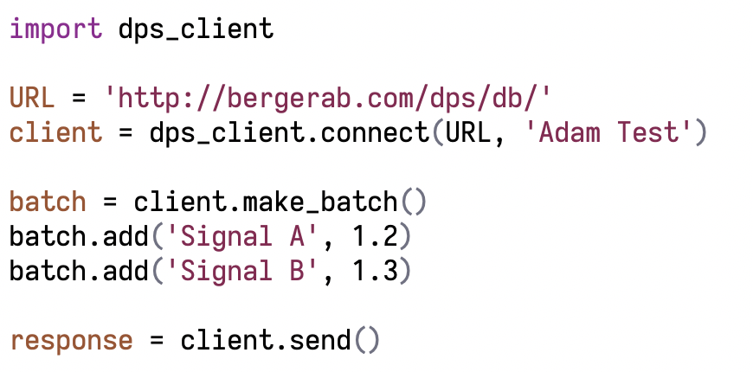
Code Base Overview – dps_client
Name of the device sending data
URL of a Database Manager
Tags signal values with the current time
Returns a Python requests response object
Sends a network request to the Database Manager

Slide 19
Code Base Overview – dps_ui
The User Interface for the system.
Requires a working DPS Manager
From dps_services
Run with:
yarn run
Uses material-ui, and React
Custom React components in src/components directory.

Slide 20
Code Base Overview – uwm
UWM specific implementations:
Database Manager for UWM TimescaleDB schema
LabVIEW integration web server for dps_client

Slide 21
Code Base Overview – dps_test
Integration tests for all micro-services in the system.
An installable Python package
“python3 setup.py install” or “pip3 install ."
Run tests by providing a URL to any DPS server:
dps_test --url http://localhost:3001
Useful for testing Eaton’s Database Manager implementation
While developing the server, run the integration test. If the tests pass, the server is compliant.

Slide 22
Code Base Overview – kpi-stream
Includes:
Original KPI code (src/kpi.py file)
Grafana dashboards (grafana directory)
Original KPI processing web server (src/main.py file)
Legacy code – superseded by DPS UI
Run with: python3 main.py
KPI code is still in use in the “DPS” design. Other code is kept for historical reasons.

Slide 23
Code Base Overview – Future Plans
Dockerfiles will be added to automate dependencies with Docker containers.
kpi-stream folder will be phased out.
KPI code will be merged with DPS code.

Slide 24
Questions?

